Slide 1
E2VENT project presentation
Event name
Presenter name, company

Slide 2
E2VENT Project
Months
project
Partners
Work
packages
Million
budget
Call EeB2014-Topic2-H2020: Adaptable envelopes integra-ted in building refurbishment projects.
E2VENT is 42 months research project funded by European Commission under the Energy Theme of the Horizon 2020 for research and Technological development.
Focus on developing an energy efficient ventilated façade system for the refurbishment of existing residential multi-storey buildings, i.e. a modular adaptable system embedding heat exchange and heat storage units to reach optimum energy performance.
Page 1

Slide 3
Introduction
Old buildings (vast majority of the building stock) are predominantly of low energy performance and subsequently in need of refurbishment work.
Within the existing European building stock approximately 34% of the multi-storey residential building stock is built in the 60’s 70’s → only few or no requirements for energy efficiency, characterized by:
high energy losses through the envelope and high energy consumption
low indoor air quality mostly related to humidity that can lead to a deterioration of the health of the end user
poor aesthetics, and a need for maintenance
Page 2

Slide 4
Introduction
E2VENT will develop, demonstrate and validate a cost effective, high energy efficient, low CO2 emissions, replicable, low intrusive, systemic approach for retrofitting of residential buildings, able to achieve remarkable energy savings, through the integration of an innovative adaptive ventilated façade system, including:
Page 3

Slide 5
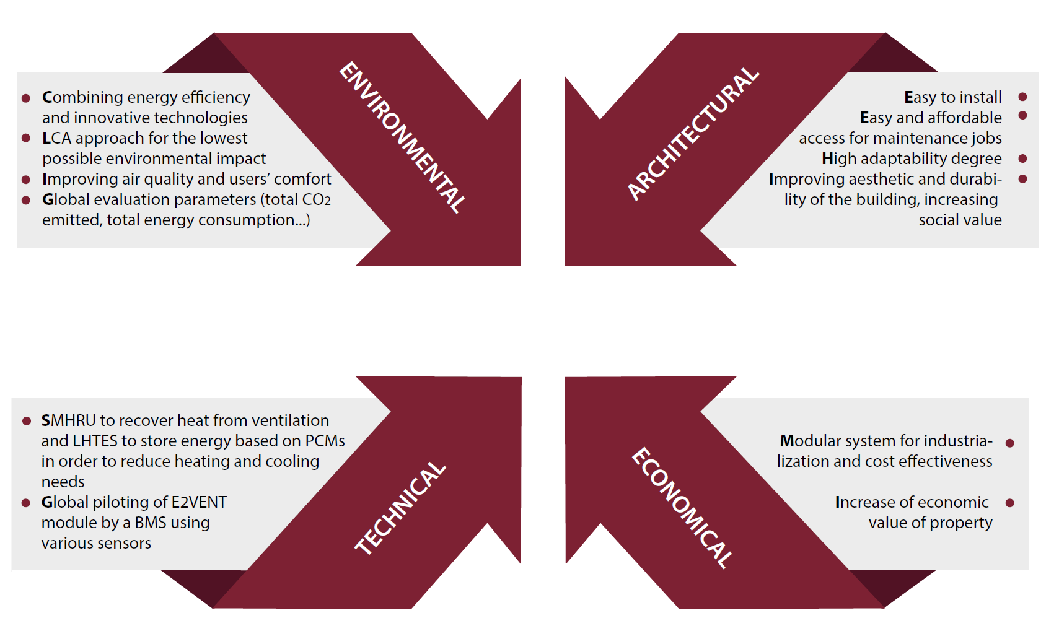
Objectives
E2VENT
Page 4

Slide 6
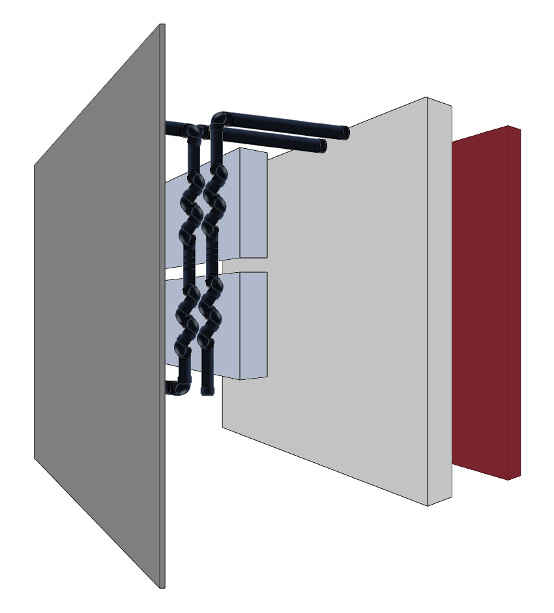
Concept
The E2VENT system is an external refurbishment solution with external cladding and air cavity that embeds different breakthrough technologies ensure its high efficiency:
A Smart Modular Heat Recovery Unit (SMHRU) for the air renewal allows the heat recovery from the extracted air using a double flux exchanger. Indoor Air Quality is ensured while limiting the energy losses.
A Latent Heat Thermal Energy Storage (LHTES) based on phase change materials will provide a heat storage system for heating and cooling peak saving.
E2VENT system
Page 5

Slide 7
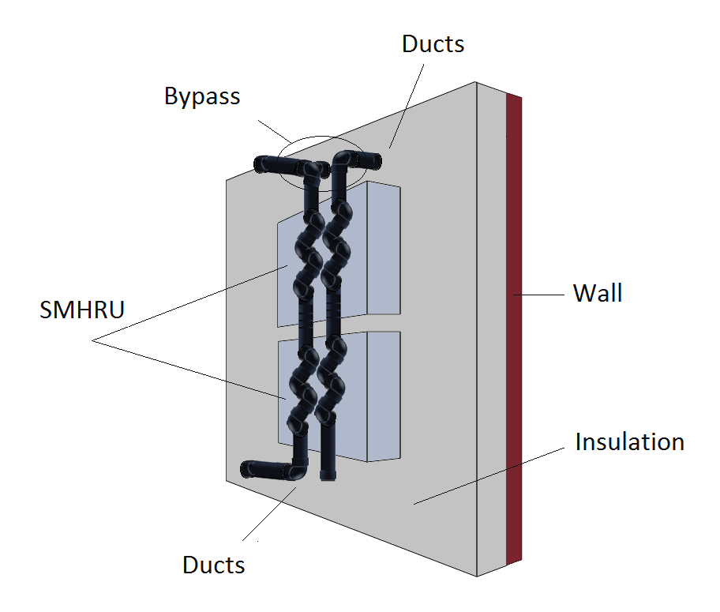
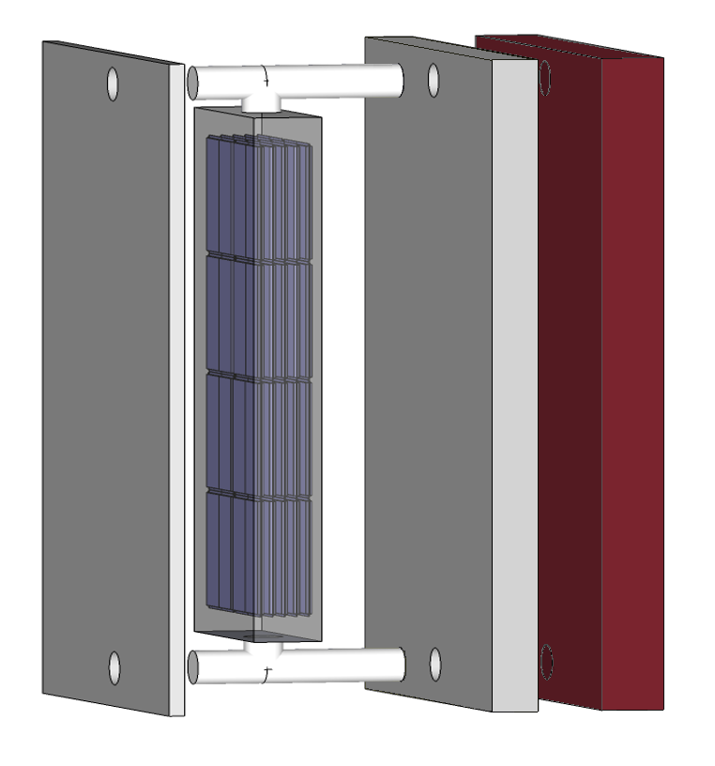
Concept
A smart management that controls the system on a real time basis targeting optimal performances. It will embed new sensors, communicate with existing systems and recover predicted weather.
An efficient anchoring system that limits thermal bridges and allows an easy and durable installation.
SMHRU Smart Modular Heat Recovery Unit
LHTES Latent Heat Thermal Energy Storage
Page 6

Slide 8
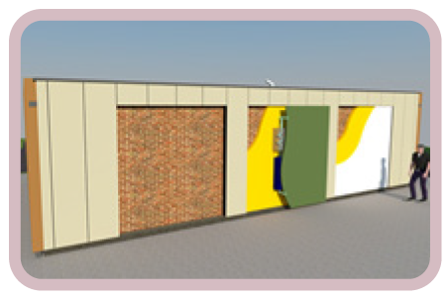
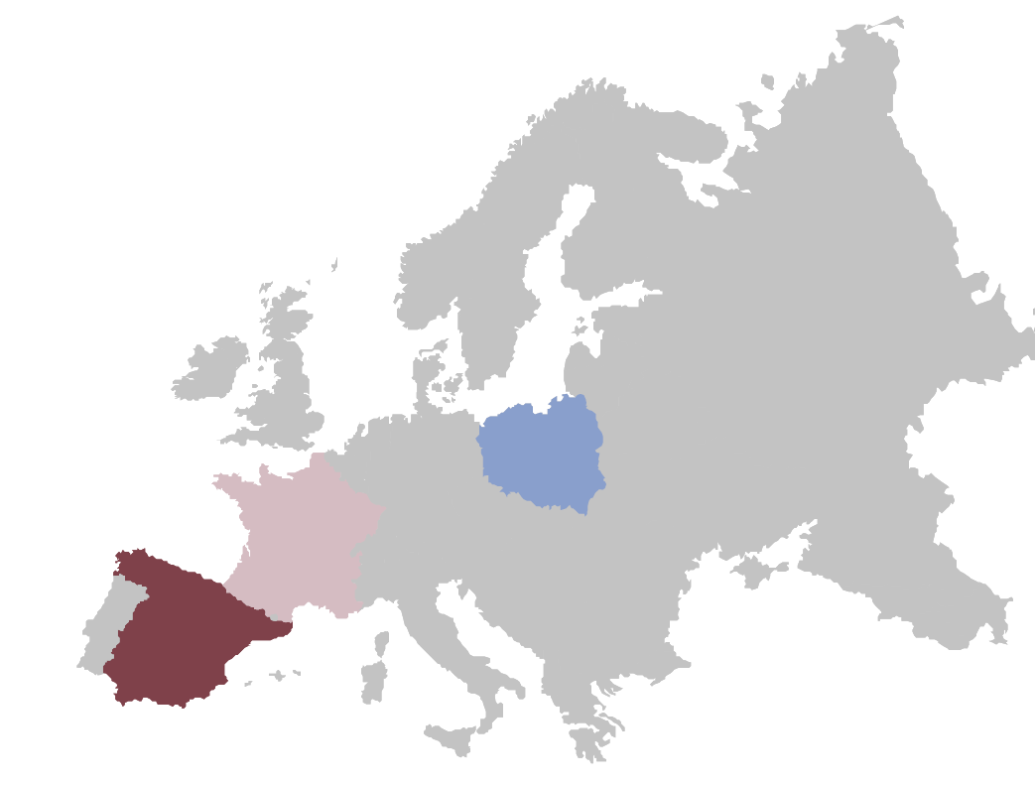
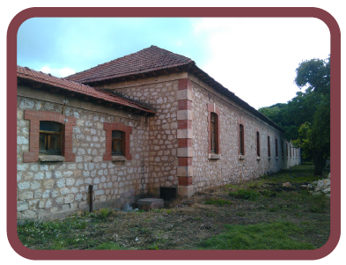
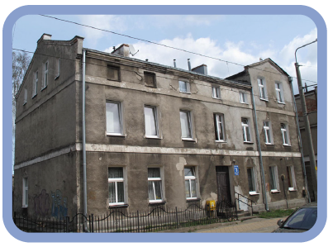
Demonstration
Prototypes performance firstly tested on the future façade test bench of Nobatek.
Two pilot buildings renovated with E2VENT systems (Poland and Spain) in order to test the E2VENT system in two different climates.
During the monitoring the potential users, financers, and partners will be consulted to develop a solution matching market needs.
Façade test bench of Nobatek with the E2VENT system
Demo building in Burgos, Spain
Demo building in Gdansk, Poland
Page 7

Slide 9
Partners
Page 8

Slide 10
Contact
For further project information please contact:
Visit the project’s website for more information:
www.e2vent.eu
Or follow project latest news on social network profiles:
ANTOINE DUGUÉ
Project coordinator
Nobatek
adugue@nobatek.com
Page 9

